Slide 1
Containers
Week 1
CLO835, Fall 2022

Slide 2
Agenda
Introduction to Containers
What is Docker
Docker Architecture
Docker Engine
Run Docker Containers
Create Docker Images
Publish Docker Images with Amazon ECR
Networks in Docker
Docker Storage
Docker Concepts in Depth
Benefits of Containerized Applications
Build and Push to Amazon ECR from Cloud9
Build and Push to Amazon ECR with GitHub Actions

Slide 3
Tell me and I forget. Teach me and I remember. Involve me and I learn.
Misattributed to Benjamin Franklin
(Probably inspired by Chinese Confucian philosopher Xunzi)

Slide 4
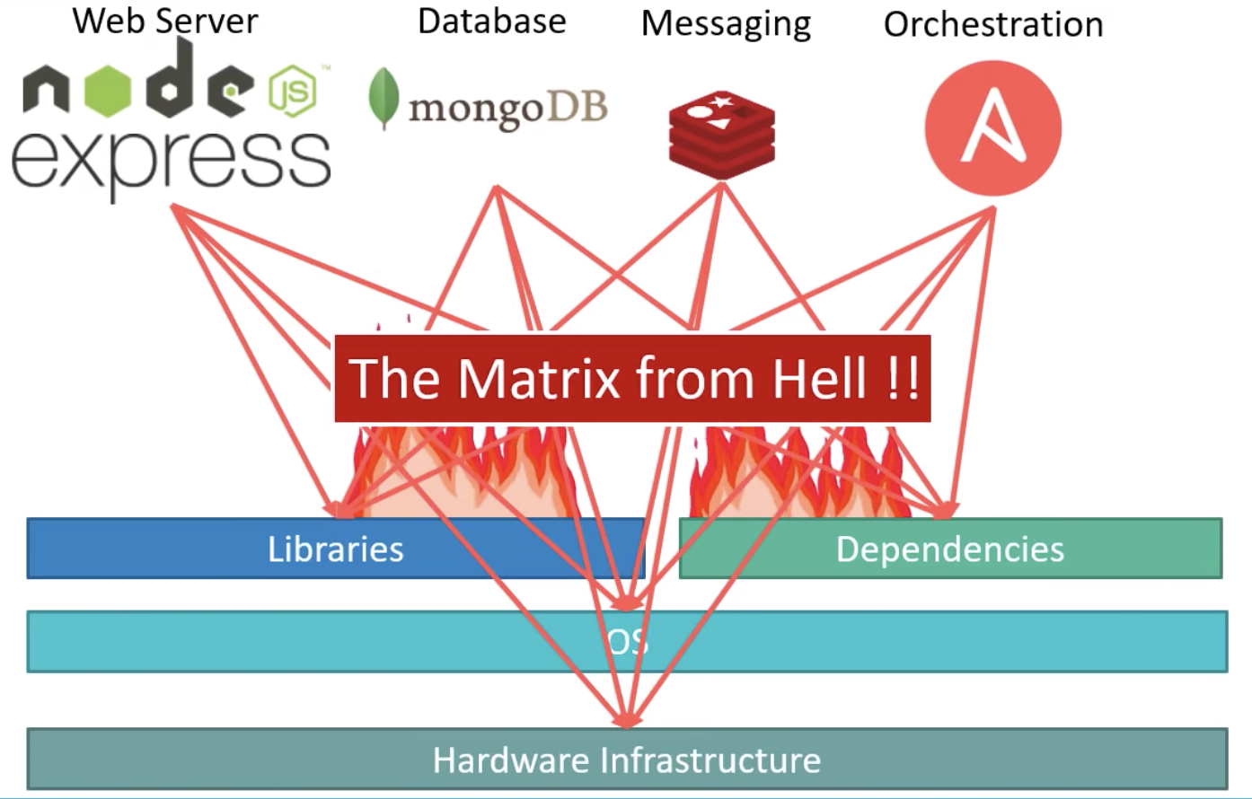
Why Containers?
The software industry has changed
Before:
monolithic applications
long development cycles
single environment
slowly scaling up
Now:
decoupled services
fast, iterative improvements
multiple environments
quickly scaling out

Slide 5
Deployment becomes very complex
Many different stacks:
languages
frameworks
databases
Many different targets:
individual development environments
pre-production, QA, staging...
production: on prem, cloud, hybrid

Slide 6
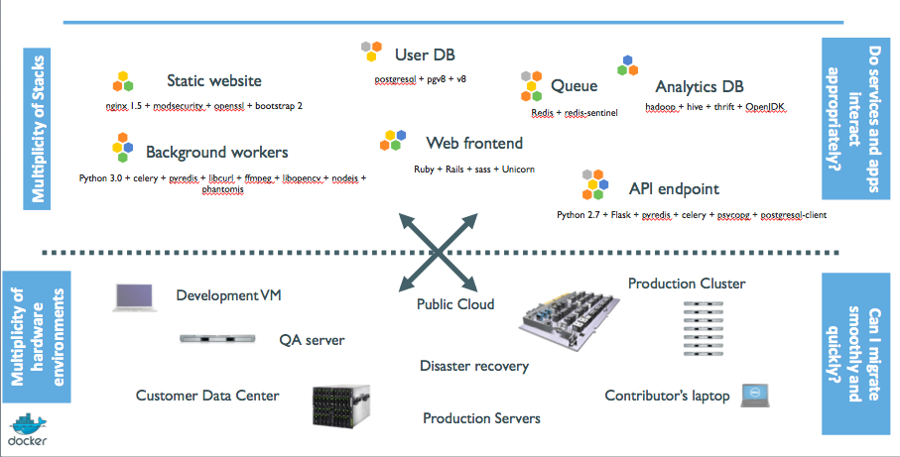
The Deployment Problem

Slide 7
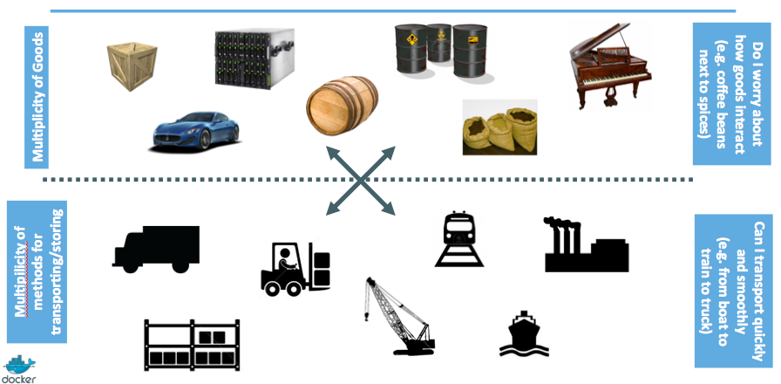
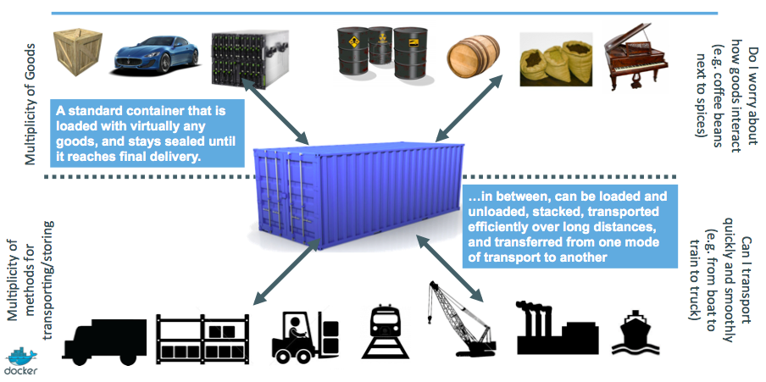
The parallel with the shipping industry

Slide 8
Escape dependency hell
Write installation instructions into an INSTALL.txt file
Using this file, write an install.sh script that works for you
Turn this file into a Dockerfile, test it on your machine
If the Dockerfile builds on your machine, it will build anywhere
Rejoice as you escape dependency hell and "works on my machine"
Never again "worked in dev - ops problem now!"

Slide 9
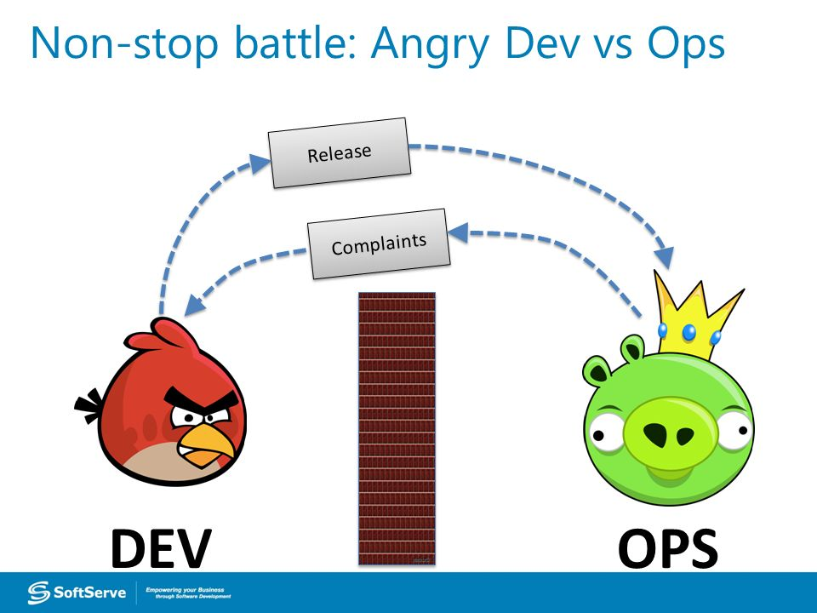
Devs vs Ops, before Docker
Drop a tarball (or a commit hash) with instructions.
Dev environment very different from production.
Ops don't always have a dev environment themselves ...
... and when they do, it can differ from the devs'.
Ops have to sort out differences and make it work ...
... or bounce it back to devs.
Shipping code causes frictions and delays.

Slide 10
Devs vs Ops, after Docker
Drop a container image or a Compose file.
Ops can always run that container image.
Ops can always run that Compose file.
Ops still have to adapt to prod environment, but at least they have a reference point.
Ops have tools allowing to use the same image in dev and prod.
Devs can be empowered to make releases themselves more easily.

Slide 11
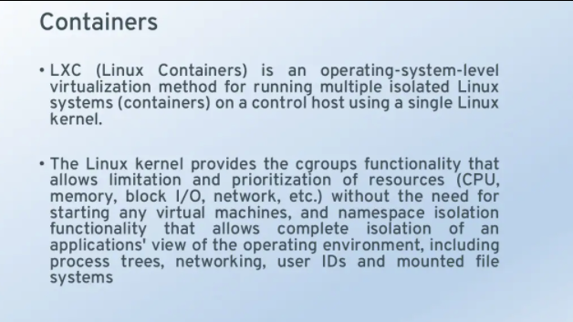
What are Containers

Slide 12
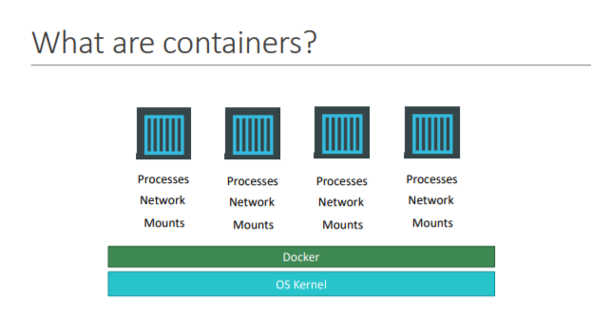

Slide 13
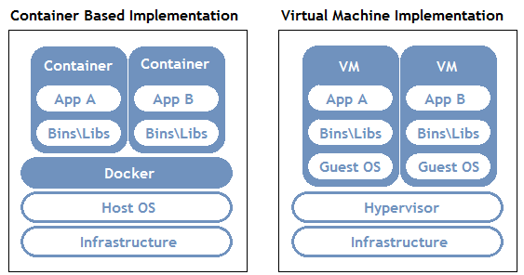
Containers vs VMs
Small and Fast
Portable
Heavy weight, non portable
Relies on OS package manager

Slide 14
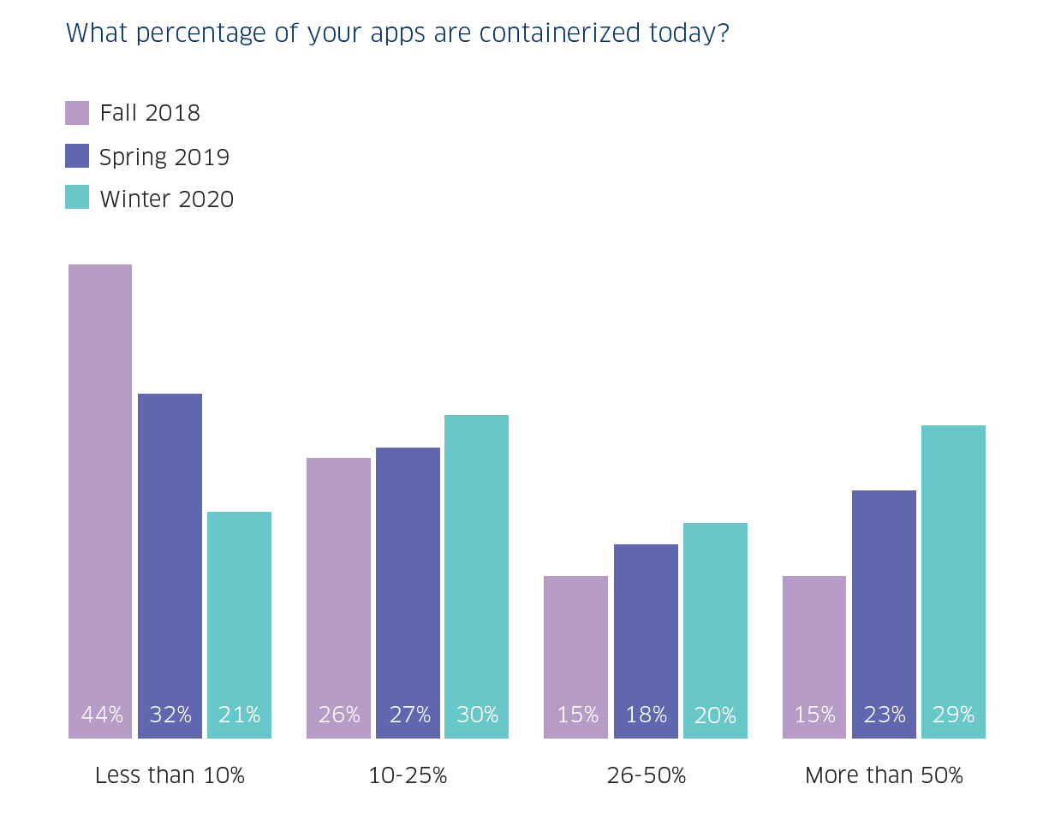
Containers Adoption Rate
Notes:
https://www.stackrox.com/post/2020/03/6-container-adoption-trends-of-2020/

Slide 15
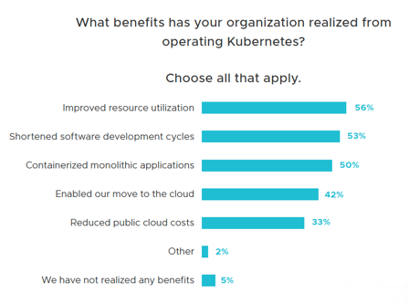
Perceived Benefits from containers adoption
Notes:
Developers reported benefits provided by the adoption of containers and K8s
What is not there?
Security and sys admin professionals did not participate. The picture might have looked differently.
Security is not on the list

Slide 16
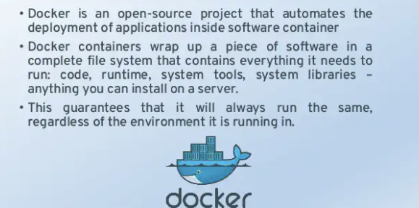
What is Docker

Slide 17
What is Docker?
"Installing Docker" really means "Installing the Docker Engine and CLI".
The Docker Engine is a daemon (a service running in the background).
This daemon manages containers, the same way that a hypervisor manages VMs.
We interact with the Docker Engine by using the Docker CLI.
The Docker CLI and the Docker Engine communicate through an API.
There are many other programs and client libraries which use that API.

Slide 18
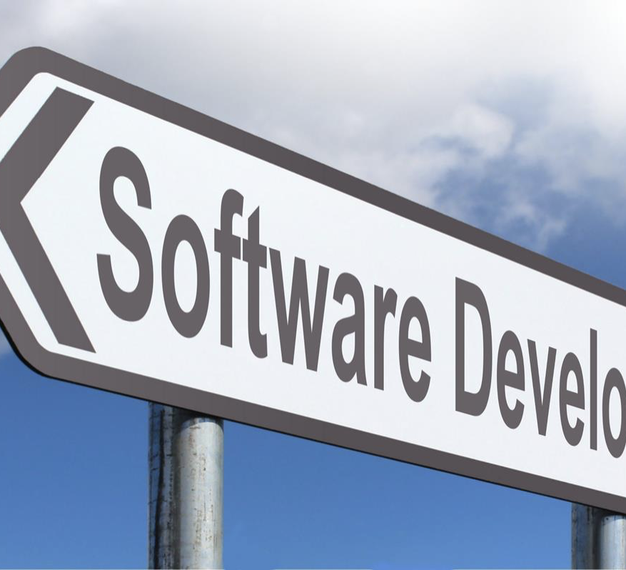






What makes docker containers so popular
Build once, run everywhere
Dependencies isolation
Ease of use with docker command line tool
Scalability with the orchestration tools
Up and running in seconds
Massive scale

Slide 19
Developers and Admins: Separation of concerns
The Developer
Responsible for the "inside" of the container
Code
Libraries
Package manager
Application
Data
All Linux servers look the same
The Administrator
Responsible for the "outside" of the container
Logging
Monitoring
Remote Access
Networking
Security
Start, stop, attach, migrate all the containerized apps the same way

Slide 20
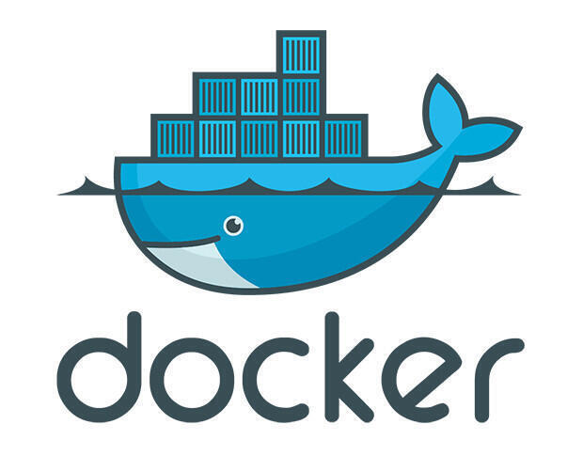
Lab1 – Run Docker Containers

Slide 21
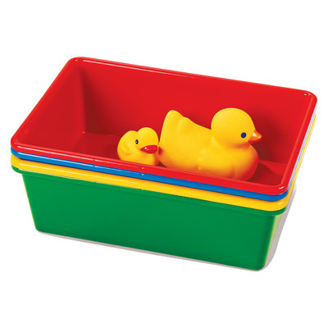
Run Docker Containers on Cloud9
We will use Cloud 9 to run the containers locally. We can run on our local machines as well, yet it will put strain on our laptop resources.
Use ”sudo” when running Docker commands
$ docker version
$ docker run busybox echo hello world
hello world

Slide 22
Run Ubuntu on Amazon Linux VM
$ docker run -it ubuntu
root@04c0bb0a6c07:/#
root@04c0bb0a6c07:/# figlet CLO830
bash: figlet: command not found
# Install figlet
root@04c0bb0a6c07:/# apt-get update
root@04c0bb0a6c07:/# apt-get install figlet
root@04c0bb0a6c07:/# figlet CLO830 # Runs successfully
root@04c0bb0a6c07:/# exit
$ figlet CLO830 # not installed on the host!
# Re-run the container – will figlet work?
$ docker run -it ubuntu
root@04c0bb0a6c07:/# figlet CLO830
This is a brand-new container.
It runs a bare-bones, no-frills ubuntu system.
-it is shorthand for -i -t.
-i tells Docker to connect us to the container's stdin.
-t tells Docker that we want a pseudo-terminal.

Slide 23
Run the Hello-World Docker container on Amazon EC2
# Create ssh key pair and Amazon Linux EC2 in a public subnet in default VPC.
# Use the provided Terraform code to deploy the EC2 instance
$ ssh-keygen –t rsa –f week1-dev
$ tf init
$ tf apply –auto-approve
# Log into the instance
$ ssh -i week1-dev <elastic IP>
# Is docker running?
# Install Docker and run Hello-World container
$ sudo yum update -y
$ sudo yum install docker -y
$ sudo systemctl start docker
$ sudo systemctl status docker
$ docker ps # Why does it fail?

Slide 24
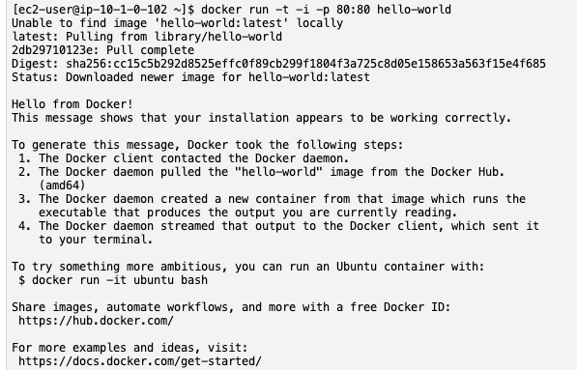
Run the Hello-World Docker container on Amazon EC2
# Who has access to this socket?
$ ls -ltra /var/run/docker.sock
# Add ec2-user to the docker group to enable docker cli use w/o sudo in the next session
$ sudo usermod -a -G docker ec2-user
# Log out of EC2 and log in again
$ docker info
$ docker run -it -p 80:80 hello-world
# List all the running containers
$ docker ps
# List all the images
$ docker images

Slide 25
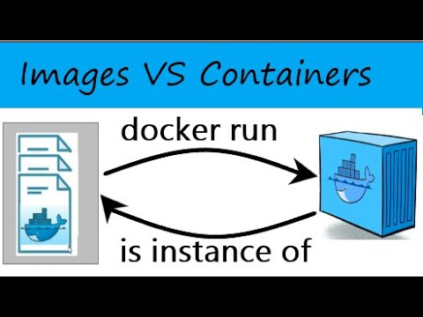
Where's my container?
Notes:
Can we reuse that container that we took time to customize?
We can, but that's not the default workflow with Docker.
What's the default workflow, then?
Always start with a fresh container. If we need something installed in our container, build a custom image.
That seems complicated!
We'll see that it's actually pretty easy!
And what's the point?
This puts a strong emphasis on automation and repeatability. Let's see why ...

Slide 26
Background and foreground
The distinction between foreground and background containers is arbitrary.
From Docker's point of view, all containers are the same.
All containers run the same way, whether there is a client attached to them or not.
It is always possible to detach from a container, and to reattach to a container.
Analogy: attaching to a container is like plugging a keyboard and screen to a physical server.

Slide 27
Docker CLI – Working with Containers
# Run the container in the background (detached)
$ docker run –d nginx
# Mapping host port to container port
$ docker run –p 8001:80 –d nginx
# Volume Mapping
$ docker run –v /tmp:/var/lib –d nginx
# Inspect Container
$ docker inspect <container id>
# List running containers
$ docker ps
# View the logs
$ docker logs <container id>
# Stop the running container
$ docker stop <container id>

Slide 28
Docker CLI – Working with Containers -Cont
# View the logs
$ docker logs <container id>
# Stop the running container
$ docker stop <container id>
# Restarting a container
$ docker start <container id>
# Executing command inside the container
$ docker exec <container name> cat /etc/hosts
$ docker attach <container id>
# List ALL containers
$ docker ps –a
# Remove the stopped container
$ docker rm <container id>
Notes:
https://stackoverflow.com/questions/72125009/why-does-echo-of-an-environment-variable-do-not-work-but-printenv-does-inside

Slide 29
Docker CLI – Working with Environment Variables
# Define environment variable $K8S_COLOR with value GREEN in your host session
$ export K8S_COLOR=GREEN
# Pass environment variable value BLUE to the Docker container and attempt to print it out
$ docker run -e K8S_COLOR=BLUE ubuntu echo $K8S_COLOR
# Explain the reason the command above did not print the environment variable value GREEN. Refer to the link in the presenter notes
# Re-run the command in the formats below
$ docker run -e K8S_COLOR=BLUE ubuntu printenv
$ docker run -e K8S_COLOR=BLUE ubuntu /bin/sh -c 'echo $K8S_COLOR'
# Explain the reason the commands above are successfully printing out the value of $K8S_COLOR as BLUE
Notes:
https://stackoverflow.com/questions/72125009/why-does-echo-of-an-environment-variable-do-not-work-but-printenv-does-inside

Slide 30
Docker CLI – Working with Docker Images
# Listing the images
$ docker images
# Remove Images
$ docker rmi ubuntu
# Download an image
$ docker run nginx
$ docker pull nginx

Slide 31
Lab 1 – The end

Slide 32
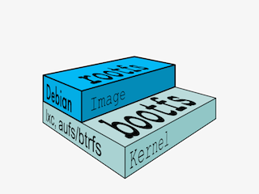
Understanding Docker Images

Slide 33
What is an image?
Image = files + metadata
These files form the root filesystem of our container.
The metadata can indicate a number of things, e.g.:
the author of the image
the command to execute in the container when starting it
environment variables to be set
etc.
Images are made of layers, conceptually stacked on top of each other.
Each layer can add, change, and remove files and/or metadata.
Images can share layers to optimize disk usage, transfer times, and memory use.

Slide 34

Image Layers Example for Java Web Applications
Each of the following items will correspond to one layer:
CentOS base layer
Packages and configuration files added by our local IT
JRE
Tomcat
Our application's dependencies
Our application code and assets
Our application configuration
(Note: app config is generally added by orchestration facilities.)

Slide 35
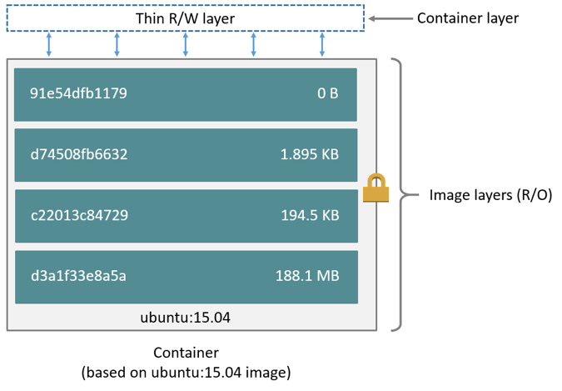
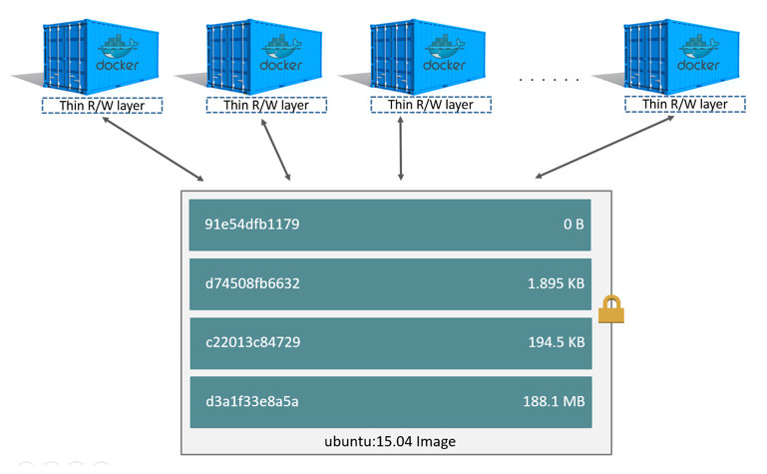
Containers and Images
An image is a read-only filesystem.
A container is an encapsulated set of processes,
running in a read-write copy of that filesystem.
To optimize container boot time, copy-on-write is used instead of regular copy.
docker run starts a container from a given image.

Slide 36
Differences between containers and images
An image is a read-only filesystem.
A container is an encapsulated set of processes, running in a read-write copy of that filesystem.
To optimize container boot time, copy-on-write is used instead of regular copy.
docker run starts a container from a given image.

Slide 37
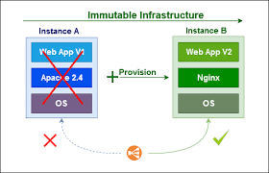
Docker Images Are Immutable. So how can we change them?
We don't.
We create a new container from that image.
Then we make changes to that container.
When we are satisfied with those changes, we transform them into a new layer.
A new image is created by stacking the new layer on top of the old image.

Slide 38
Images Namespaces
There are three namespaces:
Official images- gated by Docker Inc, authored and maintained by third parties e.g. ubuntu, busybox …
User (and organizations) images for DockerHub users e.g. igeiman/exampleapp
Self-hosted images – not hosted in DockerHub
e.g. registry.example.com:5000/my-private/image

Slide 39
Docker File
Docker can build images by reading the instructions provided in Dockerfile
A Dockerfile is a text document that contains all the commands a user could call to assemble an image
Using docker build users can create an automated build that executes a set of command line instructions in succession
The docker build command builds an image from a Docker file and a context

Slide 40
Docker File: Example
# Each instruction in this file generates a new layer that gets pushed to your local image cache
# Lines preceeded by # are regarded as comments and ignored
# The line below states we will base our new image on the Latest Official Ubuntu
FROM ubuntu:latest
# Identify the maintainer of an image
LABEL maintainer="myname@somecompany.com"
# Update the image to the latest packages
RUN apt-get update && apt-get upgrade -y
# Install NGINX to test.
RUN apt-get install nginx -y
# Expose port 80
EXPOSE 80
# Last is the actual command to start up NGINX within our Container
CMD ["nginx", "-g", "daemon off;"]
$ docker build (used 99% of the time)
Performs a repeatable build sequence.
This is the preferred method!
Images can be stored on your Docker host or in docker registry
# Adding tags
$ docker tag <image id> nginx

Slide 41
Dockerfile usage summary
Dockerfile instructions are executed in order.
Each instruction creates a new layer in the image.
Docker maintains a cache with the layers of previous builds.
When there are no changes in the instructions and files making a layer, the builder re-uses the cached layer, without executing the instruction for that layer.
The FROM instruction MUST be the first non-comment instruction.
Lines starting with # are treated as comments.
Some instructions (like CMD or ENTRYPOINT) update a piece of metadata.
(As a result, each call to these instructions makes the previous one useless.)

Slide 42
The RUN instruction
The RUN instruction can be specified in two ways.
With shell wrapping, which runs the specified command inside a shell, with /bin/sh -c:
RUN apt-get update
Or using the exec method, which avoids shell string expansion, and allows execution in images that don't have /bin/sh:
RUN [ "apt-get", "update" ]

